Slide 1
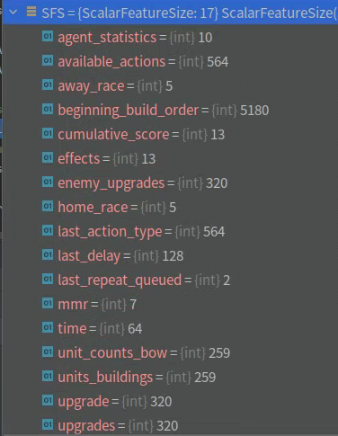
FC
FC
Embedded scalar shape(128,)
Concatenate + Fc
16个标量特征
Begin build order
Shape(20*259)
FC
......
Concatenate + Fc
Scalar context (128,)
FC
transformer
Scalar embedding

Slide 2
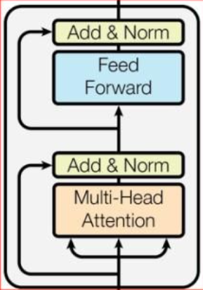
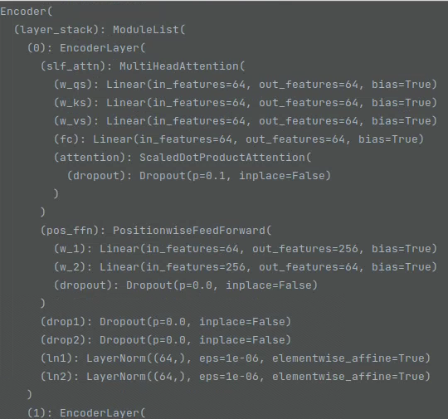
输出
1. Embedded entity : shape(64, )
2. Entity embeddings : shape(512, 64)
3. Entity numbers: shape(1,)
当前非padding的entity个数
4. Unit types: shape(512,)
每个unit(entity)的类型
FC
Shape(1856, 64)
Mean
Input:
Entity features: shape(512, 1856)
Padding entity为全0向量
Entity embedding

Slide 3
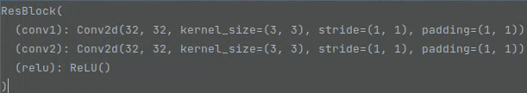
Entity embeddings: shape (512, 64)
Scatter entity(16*64*64)
Kernel size=1
Output
shape(16, 64, 64)
Embedding + conv2d
Down Sample
32*8*8
Split
conv2d
Shape (20*64*64)
ResBlock
前4个channel表示entity所在的位置，将其split 出来
Input:
Feature map: shape(24*64*64)
Output
Map skips: 5个 32*8*8的ResBlock中间层
Embedded spatial: shape(64,)
FC
Spatial embedding

Slide 4
Hidden state
Embedded entity
Embedded spatial
Embedded scalar
Core:
LSTM(256, 128)
Concatenate
LSTM output: shape(128,)
Hidden state
LSTM Core

Slide 5
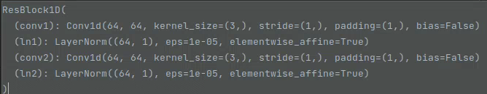
FC + Sigmoid
Context scalar
Mask Softmax
Action logits: (564,)
FC +ResBlock
FC
LSTM output
FC
监督学习时为teaching force即使用ground truth 的 action
Sample
FC
Sampled action type autoregressive embedding
FC
Action type head

Slide 6
autoregressive embedding
FC
Delay logits
Sample
FC
autoregressive embedding
Sampled delay
Delay head

Slide 7
FC
Queue logits
autoregressive embedding
Sample
Mask FC
autoregressive embedding
Sampled Queue
Queue head

Slide 8
Create mask
Action type
Unit type mask
mask
logits
sample
autoregressive
embedding
FC
dot attention
FC
autoregressive
embedding
LSTM
Query
Zero hidden
Entities embeddings
x12
Select entity heads

Slide 9
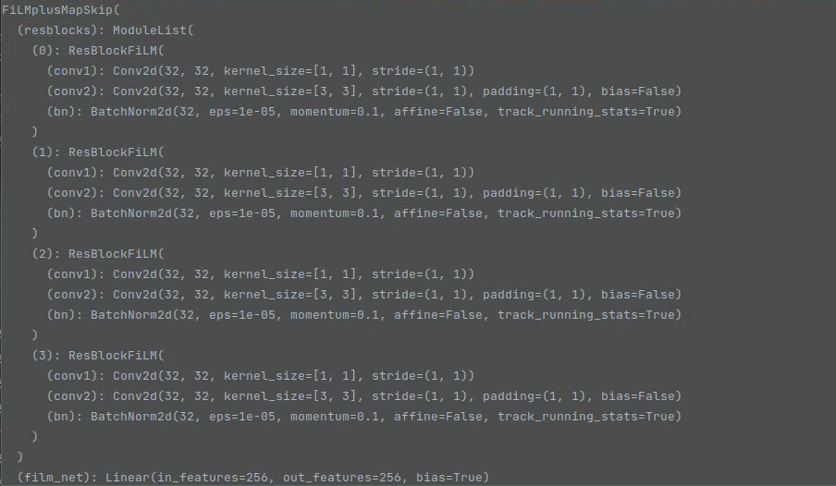
ResBlock + FC
GLU
Gated by autoregressive
embedding
Target location logits
Map skips
autoregressive
embedding
Target location heads

Slide 10
State
Concatenate + FC + ResBlock1D + FC
Baseline
LSTM Output
x5
Winloss, build_order, built_units, upgrades, effects
Baseline head

Slide 11
Create league
Create global learned model
调用shared memory 将在cuda设备中的model 共享
Main process
Coordinator process
win loss queue, coordinator 通过queue接受actor传过来的对战结果，更新league中的pay off情况。
Actor
Actor
Actor
Actor
每个actor 和 learner为一个thread，每个thread都维护一个local的agent(model)
Actor定期将收集到的轨迹数据放到learner中，定期同步learner的局部模型的参数
Learner通过局部模型计算梯度，将梯度传给global model, 更新global model 的参数，并定期同步global model 的参数（10秒）
Learner
Learner
Actor-learner process
Actor-learner process
Actor
Actor
Actor
Actor
Learner
Learner
A3C的架构，hogwild 的更新全局模型的方式（更新模型参数时不加锁）
Actor-learner process
Actor-learner process

